Slide 1
Introduction to Embedded & Real-Time Systems
Scheduling and Concurrency
Sathish Gopalakrishnan
Electrical and Computer Engineering
The University of British Columbia

Slide 2
Outline of This Lecture
Concurrency Primitives
Real-time systems
Characteristics
Example real-time systems
Terminology
Hard and soft real-time systems
Rate-Monotonic Analysis (RMA)
Next week

Slide 3
Process State
Waiting
for
Event
event
occurred
task
deleted
wait for
event
context switch
task delete
Ready
Running
Dormant
task create
context switch
interrupted
task deleted
Interrupted

Slide 4
Process Scheduling
What is the scheduler?
Part of the operating system that decides which process/task to run next
Uses a scheduling algorithm that enforces some kind of policy that is designed to meet some criteria
Criteria may vary
CPU utilization ­ keep the CPU as busy as possible
Throughput ­ maximize the number of processes completed per time unit
Turnaround time ­ minimize a process’ latency (run time), i.e., time between task submission and termination
Response time ­ minimize the wait time for interactive processes
Real-time ­ must meet specific deadlines to prevent “bad things” from happening

Slide 5
Ready List
Ready
List
NULL
Process
Control
Block
Process
Control
Block
Process
Control
Block

Slide 6
FCFS Scheduling
First­come, first­served (FCFS)
The first task that arrives at the request queue is executed first, the second task is executed second and so on
Just like standing in line for a roller­coaster ride
FCFS can make the wait time for a process very long
Process Total Run Time
P1 12 seconds
P2 3 seconds
P3 8 seconds
P1
P2
P3
If arrival order is P1, P2, P3
P2
P3
P1
If arrival order is P2, P3, P1

Slide 7
Shortest ­Job­ First Scheduling
Schedule processes according to their run-times
Process Total Run Time
P1 5 seconds
P2 3 seconds
P3 1 second
P4 8 seconds
May be run­time or CPU burst­time of a process
CPU burst time is the time a process spends executing in-between I/O activities
Generally difficult to know the run-time of a process
P3
P2
P1
P4

Slide 8
Priority Scheduling
Shortest­ Job ­First (SJF) is a special case of priority scheduling
Priority scheduling assigns a priority to each process. Those with higher priorities are run first.
Priorities are generally represented by numbers, e.g., 0..7, 0..4095
No general rule about whether zero represents high or low priority
We'll assume that higher numbers represent higher priorities
Process BurstTime Priority
P1 5 seconds 6
P2 3 seconds 7
P3 1 second 8
P4 8 seconds 5
P3
P2
P1
P4

Slide 9
Interactions Between Processes
Multitasking a multiple processes/tasks providing the illusion of “running in parallel”
Perhaps really running in parallel if there are multiple processors
A process/task can be stopped at any point so that some other process/task can run on the CPU
At the same time, these processes/tasks running on the same system might interact
Need to make sure that processes do not get in each other’s way
Need to ensure proper sequencing when dependencies exist
Rest of lecture: how do we deal with shared state between processes/tasks running on the same processor?

Slide 10


Critical Section
Piece of code that must appear as an atomic action
Atomic Action ­ action that “appears” to take place in a single indivisible operation
process one process two
Balance += 20; Balance -= 20;
if “+=, -=” can execute atomically, then there is no race condition
Race condition ­ outcome depends on the particular order in which the operations takes place
Notes:
What are the possible values of balance? (Assume balance starts at $100)

Slide 11
Semaphores
Semaphore ­ an integer variable (> 0) that normally can take on only non­zero values
Only three operations can be performed on a semaphore ­ all operations are atomic
init(s, #)
Sets semaphore, s, to an initial value #
wait(s) or P(s)
If s > 0, then s = s ­ 1;
Else suspend the process that called wait
signal(s) or V(s)
s = s + 1;
If some process P has been suspended by a previous wait(s), wake up process P
The process waiting the longest gets woken up
Notes:
11

Slide 12
Types of Synchronization with Semaphores
There are 2 basic types of synchronization
Mutex – where semaphores serve to protect a critical section (shared data/code)
Barrier synchronization – where semaphores are used - sort of - as an inter-task communication facility to “wake up” other waiting processes
Remember P=wait and V=signal
Here, s1 and s2 are semaphores
P1
P(s1)
...
V(s1)
P2
P(s1)
...
V(s1)
P1
P(s1)
...
V(s2)
P2
P(s2)
...
V(s1)
Initial value of s1 = 1
Mutex
Barrier Synchronization
Initial value of s1 = 1, s2 = 0
Notes:
12
https://en.wikipedia.org/wiki/Semaphore_(programming)#Operation_names The canonical names V and P come from the initials of Dutch words. V is generally explained as verhogen ("increase"). Several explanations have been offered for P, including proberen ("to test" or "to try"),^{[4]} passeren ("pass"), and pakken ("grab"). Dijkstra's earliest paper on the subject^{[2]} gives passering ("passing") as the meaning for P, and vrijgave ("release") as the meaning for V. It also mentions that the terminology is taken from that used in railroad signals. Dijkstra subsequently wrote that he intended P to stand for the portmanteau prolaag,^{[5]} short for probeer te verlagen, literally "try to reduce," or to parallel the terms used in the other case, "try to decrease."^{[6][7][8]}

Slide 13
Atomic SWAP Instruction on the ARM
SWP combines a load and a store in a single, atomic operation
ADR r0, semaphore
SWPB r1, r1,[r0]
SWP loads the word (or byte) from memory location addressed in Rn into Rd and stores the same data type from Rm into the same memory location
SWP<cond> {B} Rd, Rm, [Rn]
Notes:
Software synchronization without requiring disabling of interrupts
http://infocenter.arm.com/help/index.jsp?topic=/com.arm.doc.dht0008a/CJHBGBBJ.html

Slide 14
ARM Binary Mutex
locked EQU 1
unlocked EQU 0
lock_mutex_swp PROC
LDR r2, =locked
SWP r1, r2, [r0] ; Swap R2 with location [R0], [R0] value placed in R1
CMP r1, r2 ; Check if memory value was ‘locked’
BEQ lock_mutex_swp ; If so, retry immediately
BX lr ; If not, lock successful, return
ENDP
unlock_mutex_swp PROC
LDR r1, =unlocked
STR r1, [r0] ; Write value ‘unlocked’ to location [R0]
BX lr
ENDP
Notes:
http://infocenter.arm.com/help/index.jsp?topic=/com.arm.doc.dht0008a/CJHBGBBJ.html
https://www.doulos.com/knowhow/arm/Hints_and_Tips/Implementing_Semaphores/ says “In some systems, especially complex SoCs with fast application processors, SWP can create a critical performance bottleneck. In these systems memory latency is long compared to core cycle time. That means that while SWP executes, interrupts cannot be served for perhaps many cycles. It also means that while SWP blocks the system bus, no other master can carry out any access, even if it is completely unrelated.”

Slide 15
ARM Binary Mutex v6 and on
locked EQU 1
unlocked EQU 0
lock_mutex PROC
LDR r1, =locked
1 LDREX r2, [r0]
CMP r2, r1 ; Test if mutex is locked or unlocked
BEQ %f2 ; If locked - wait for it to be released, from 2
STREXNE r2, r1, [r0] ; Not locked, attempt to lock it
CMPNE r2, #1 ; Check if Store-Exclusive failed
BEQ %b1 ; Failed - retry from 1
; Lock acquired
DMB ; Data memory barrier
BX lr
2 ; Take appropriate action while waiting for mutex to become unlocked
WAIT_FOR_UPDATE
B %b1 ; Retry from 1
ENDP
Notes:
http://infocenter.arm.com/help/index.jsp?topic=/com.arm.doc.dht0008a/CJHBGBBJ.html
https://www.doulos.com/knowhow/arm/Hints_and_Tips/Implementing_Semaphores/
“Exclusive load (LDREX) reads data from memory, tagging the memory address at the same time. Exclusive store (STREX) stores data to memory, but only if the tag is still valid. Otherwise memory will not be modified. Every memory access to the same address between LDREX and STREX will invalidate the tag. With this mechanism, bus masters won't be locked out from memory access altogether, but only if they access the same location. Since there can be any instruction sequence (preferably a short one) between the LDREX and the STREX, any type of semaphore could be implemented with this instruction pair”

Slide 16
ARM Binary Mutex v6 and on
locked EQU 1
unlocked EQU 0
; unlock_mutex
; Declare for use from C as extern void unlock_mutex(void * mutex);
EXPORT unlock_mutex
unlock_mutex PROC
LDR r1, =unlocked
DMB ; Required before releasing protected resource
STR r1, [r0] ; Unlock mutex
SIGNAL_UPDATE
BX lr
ENDP
Notes:
http://infocenter.arm.com/help/index.jsp?topic=/com.arm.doc.dht0008a/CJHBGBBJ.html
https://www.doulos.com/knowhow/arm/Hints_and_Tips/Implementing_Semaphores/ says “In some systems, especially complex SoCs with fast application processors, SWP can create a critical performance bottleneck. In these systems memory latency is long compared to core cycle time. That means that while SWP executes, interrupts cannot be served for perhaps many cycles. It also means that while SWP blocks the system bus, no other master can carry out any access, even if it is completely unrelated.”

Slide 17
ARM Power Saving
MACRO
WAIT_FOR_UPDATE
WFE ; Indicate opportunity to enter low-power state
MEND
MACRO
SIGNAL_UPDATE
DSB ; Ensure update has completed before signalling
SEV ; Signal update
MEND
Notes:
http://infocenter.arm.com/help/index.jsp?topic=/com.arm.doc.dht0008a/CJAHGJEF.html
DSB waits – data synchronization barrier – no instruction after can execute until this completes

Slide 18
The Producer/­Consumer Problem
One process produces data, the other consumes it
Example: I/O from keyboard to terminal
producer(){ consumer(){
while(1){ while(1){
produce(); wait(itemReady);
appendToBuffer(); takeFromBuffer();
signal(itemReady); consume();
} }
} }
Initially, itemReady = 0
Notes:
18

Slide 19
Another Producer/Consumer
What if both appendToBuffer() and takeFromBuffer() cannot overlap in execution?
For example, if buffer is a shared link list between producer and consumer?
Or, multiple producers and consumers
producer() { consumer() {
while(1){ while(1){
produce(); wait(itemReady);
wait(mutex); wait(mutex);
appendToBuffer(); takeFromBuffer();
signal(mutex); signal(mutex);
signal(itemReady); consume();
} }
} }
Initially, mutex = 1, itemReady = 0
Notes:
19

Slide 20
Bounded Buffer Problem
Assume a single buffer of fixed size
Consumer blocks (sleeps) when buffer is empty
Producer blocks (sleeps) when the buffer is full
producer() { consumer() {
while(1) { while(1){
produce; wait(itemReady);
wait(spacesLeft); wait(mutex);
wait(mutex); takeFromBuffer;
appendToBuffer; signal(mutex);
signal(mutex); signal(spacesLeft);
signal(itemReady); consume();
} }
} }
Initially, s = 1, n = 0; e = sizeOfBuffer;

Slide 21
Deadlocks
When a program is written carelessly, it may cause a... deadlock!
P1::
P(s1);
P(s2);
...
V(s2);
V(s1);
P2::
P(s2);
P(s1);
...
V(s1);
V(s2);
Notes:
21

Slide 22
Deadlocks
Several processes “executing” at the same time, and one is waiting (blocked) for (by) another, which in turn is waiting for another, which in turn... which in turn is waiting for the first.
No process can finish, since they are all waiting for something
The difference between deadlock and starvation of a process is that
In deadlock, a process must be able to acquire a resource at first, and then go into deadlock.
In starvation, the request may be deferred infinitely
The resource may be in use for an infinite amount of time
Notes:
22

Slide 23
Resources
What could be a resource?
Hardware devices e.g. printer, eeprom needed by a process to do useful work
Software resource e.g. mutex
Processes utilize resources in the following sequence
Request (must wait if request is not granted)
Use
Release
How do we get into a deadlock?
Consider a system with one printer and one eeprom
Process 1 requests printer and the request is granted
Process 2 requests eeprom and the request is granted
Process 1 also needs eeprom to finish its job
Must wait for Process 2 to release eeprom
Process 2 also needs printer to finish its job
Must wait for Process 1 to release eeprom
Deadlock!
Notes:
23

Slide 24
Necessary Conditions for a Deadlock
Formally: (all of these conditions must hold for deadlock to occur)
Mutual exclusion: some resource is non­sharable, (eg, a printer)
Hold and wait: there must exist a process holding for a resource (e.g, a printer) and waiting for another resource (eg, a scanner)
No preemption: the system will not preempt the resources in contention
Circular wait: there must exist a circular chain of processes.
One is holding a resource and waiting for the next process
Notes:
24

Slide 25
Deadlock Handling
Prevention: structure the system is such a way as to avoid deadlocks (i.e., in a way to avoid one of the conditions above).
This is done in the design phase: design a system and ensure that there is no deadlock in the system
Avoidance: does not make deadlock impossible (as in prevention)
Instead, it rejects requests that cause deadlocks by examining the requests before granting the resources. If there will be a deadlock, reject the request
Detection and Recovery: After the deadlock has been detected, break one of the 4 conditions above.
The mechanisms of deadlock detection and deadlock recovery are very much tied to each other
Notes:
25

Slide 26
Deadlock Prevention
Ensure one of the four necessary condition is never satisfied
Allow all resources to be shared (so prevent mutual exclusion)
Some resources are inherently non-sharable
Don’t allow hold and wait, i.e., force processes to either acquire all the needed resources or to release the acquired (currently held) resources if one or more requests are not granted
Starvation of processes that need many resources
Allow preemption of resources
Enforce total ordering in resource acquisition process and require each process to request resources in an increasing order
Example: Printer order=3, EEPROM order = 7
If process 1 needs printer and EEPROM in any order, it must request printer first and then EEPROM
Can cause deadlock
Prevents deadlock
P1::
P(s1);
P(s2);
...
V(s2);
V(s1);
P2::
P(s2);
P(s1);
...
V(s1);
V(s2);
P1::
P(s1);
P(s2);
...
V(s2);
V(s1);
P2::
P(s1);
P(s2);
...
V(s1);
V(s2);
Notes:
26

Slide 27
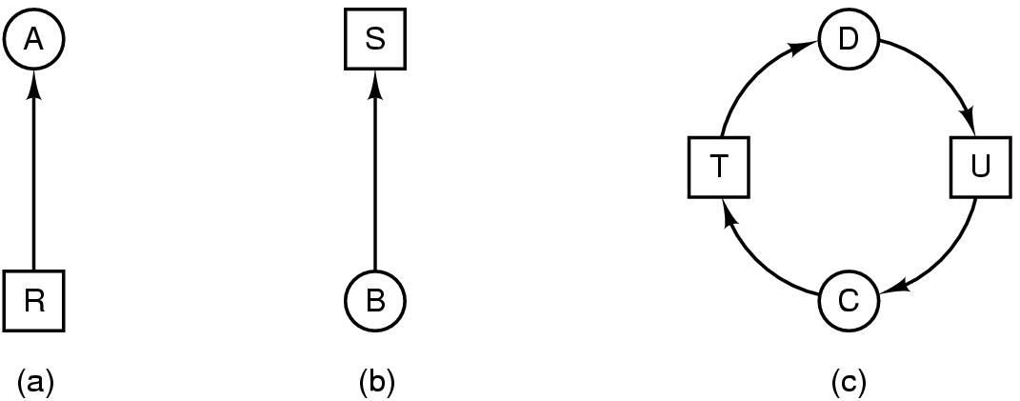
Deadlock Detection
Graph models for deadlock detection
If each resource has a single instance in a system, a directed graph model can directly tell you if there is a deadlock in the system
Called resource allocation graph
Resource R assigned to process A
Process B is requesting/waiting for resource S
Process C and D are in deadlock over resources T and U
Source: Modern Operating Systems by A. Tanenbaum
Notes:
27

Slide 28
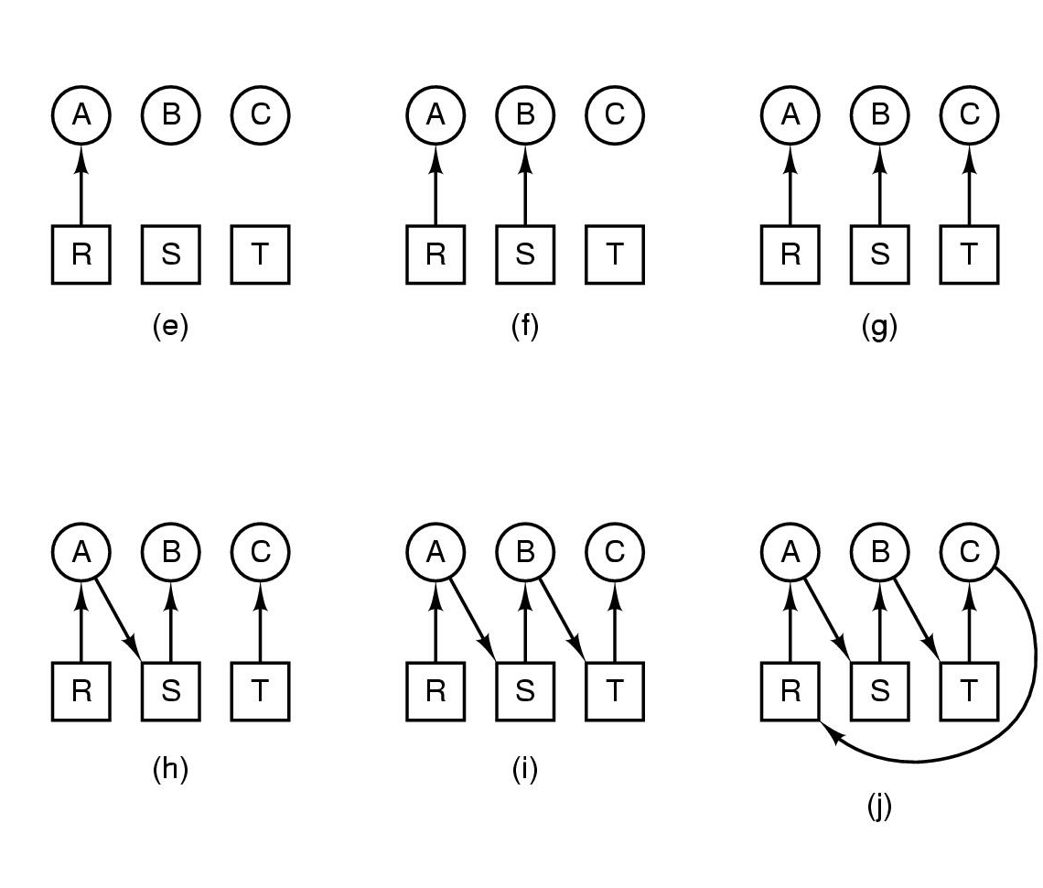
Deadlock detection with one resource of each type
Source: Modern Operating Systems by A. Tanenbaum
Notes:
28

Slide 29
Real-Time Basics
Real-time systems
Monitor, respond to, or control an external environment
Consist of sensors, actuators and other input-output interfaces
Reactive systems: respond to, or react to, signals from the environment
Subject to both temporal and logical constraints
Examples of real-time systems
Transportation: automobiles, railways, subways, aircraft, ships, elevators
Traffic control: airspace, highways, shipping
Medical: pacemakers, radiation, patient monitoring
Military: command and control, missile defense, radar tracking
Manufacturing: automated plants
Any other examples?

Slide 30

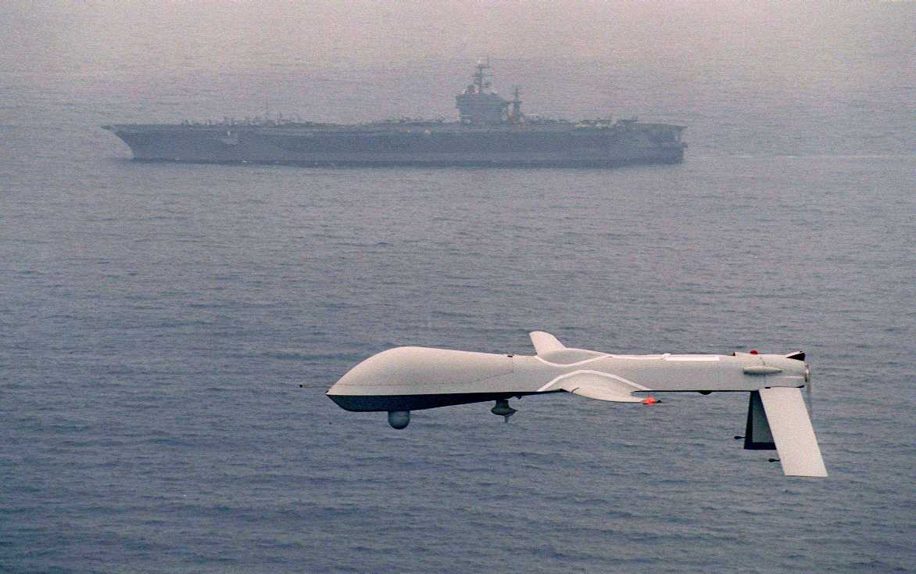
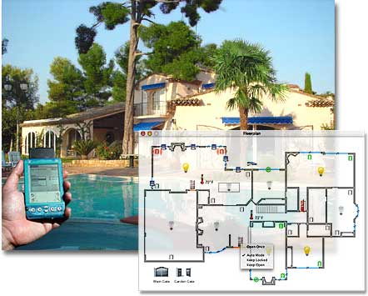

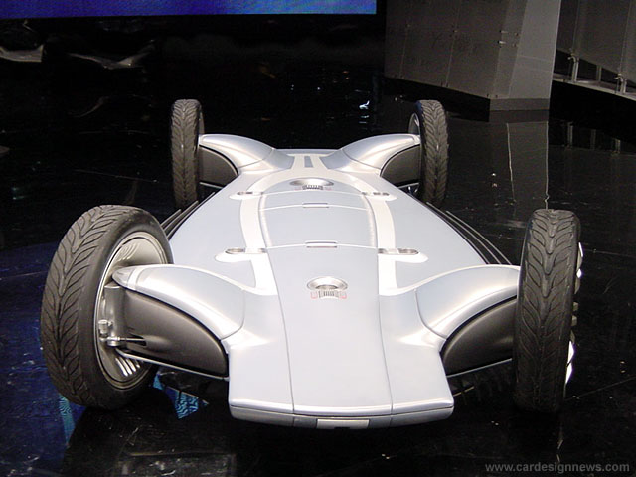

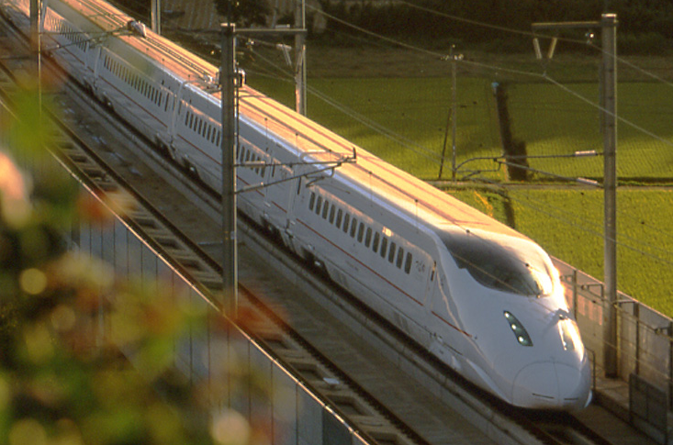
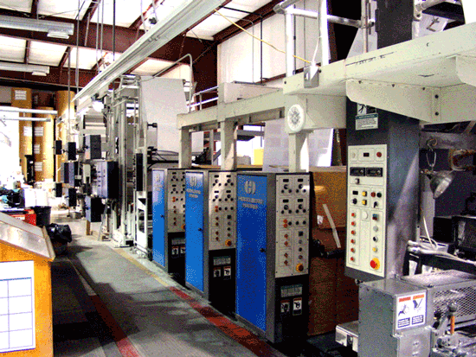
Examples of Real-Time Systems

Slide 31
What Makes a Real-Time Program Different?
What does real-time mean?
A real-time service is one that is required to be delivered within time intervals dictated by the environment
Temporal constraints are a part of the results’ correctness criteria
What makes a real-time program different?
Timing constraints
Must satisfy timing constraints involving relative and absolute times
Example: a deadline is a limit on the amount of time for completing an operation or a computation
Concurrency
Must deal with the natural concurrency of the physical world
Sensors can fire simultaneously
Environmental signals can arrive at the same time
Needs information about real-world time and multiple threads of execution

Slide 32
“Real-Time” Does Not Mean “Fast”
“Real-time” does not mean “fast”
Real-time = meeting timing constraints
Fast = doing something quickly
Real-time system can be slow
Fast system can be non-real-time
Of course, most real-time systems are designed to be fast and to operate at high speeds

Slide 33
Representation of a Real-Time Task
C
D
(i-1)T
iT
(i+1)T
Real-time periodic task represented as (C, T, D)
C = worst-case computation/execution time of process/task P
T = period or cycle time (how often the process/task P is activated)
D = deadline for completing execution of process/task P
Constraints
C <= D <= T

Slide 34
Terminology
Deadline
End of a time interval within which a real-time service is required to be delivered
Liveline
Start of a time interval within which a real-time service is required to be delivered
Targetline
Time at which the system designer aims to deliver the real-time service
Priority
Measure of the cost of missing the timing constraints, or deadlines
Higher the cost of the task missing its deadline, the higher the task’s priority

Slide 35
Hard Real-Time Systems
Hard real-time systems
Must meet timing constraints without exception
Has zero/negative utility if delivered outside a certain time interval
If a timing constraint is violated, system fails, often with catastrophic consequences
Example: automobile braking system
Increasing
Benefit
Liveline
Deadline
Zero
Benefit
Increasing Time
Increasing
Cost
Targetline

Slide 36
Soft Real-Time Systems
Soft real-time systems
Can be considered successful despite missing some timing constraints
Has positive, but sub-optimal, utility if delivered outside a certain time interval
Might have zero/negative utility if delivered outside a wider time interval
Example: telephone system that occasionally fails to make a connection
Increasing
Benefit
Deadline
Liveline
Zero
Benefit
Increasing Time
Increasing
Cost
Targetline

Slide 37
Non Real-Time Systems
Increasing
Benefit
Liveline
Zero
Benefit
Increasing Time
Increasing
Cost
Targetline

Slide 38
Kinds of Real-Time Tasks
Periodic processes/tasks
Time-driven or synchronous
Activated on a regular basis between fixed time intervals
For periodic polling, monitoring or sampling of sensors
Sporadic processes/tasks
Event-driven or asynchronous
Activated by an external entity or an environmental change
For events such as faults or mode changes
Aperiodic processes/tasks
Event-driven or asynchronous
Multiple simultaneously or closely arriving events
For bursty events or bursty actions

Slide 39
Bounded-Demand Design
Do not take the possibility of missing deadlines into account when designing the system because
A system that fails to meet its deadlines is not a real-time system
Arrangements to tolerate missed deadlines are not interesting cases
Design the system to assure that deadlines are always met
System never goes out of its operational envelope
How do you go about doing this?
When is this a useful practice?
When is this not feasible?

Slide 40
Unbounded-Demand Design
Design the system to take into account the possibility of missed deadlines because
It is not always possible to guarantee that deadlines will be met because the system environment is not completely certain
Arrangements to tolerate missed deadlines are interesting
Notion of graceful degradation – what happens when you miss a deadline?
Notion of behavior outside of the operational envelope
When does this makes sense?
How do you go about doing this?

Slide 41
Bounded vs. Unbounded Demand
To design for behavior outside the operational envelope
A larger operational envelope must be defined – how large?
With bounded-demand, what do we do if the system does go outside the operational envelope, e.g., earthquake?
Graceful degradation is probabilistic service with no tight guarantees
Results of arguments
Bounded-demand model for hard real-time services
Unbounded-demand model for soft real-time services
Hard real-time tasks must be able to preempt the resources in a bounded time
Hard real-time tasks must be able to acquire I/O channels in a bounded time

Slide 42
Priority Inversion
Priority inversion
Delay of a higher-priority task’s execution caused by interference from lower priority tasks
Sources of priority inversion
Synchronization and mutual exclusion
Non-preemptable regions of code
FIFO (first-in-first-out) queues
Ways to avoid priority inversion
Priority inheritance & priority ceiling protocols

Slide 43
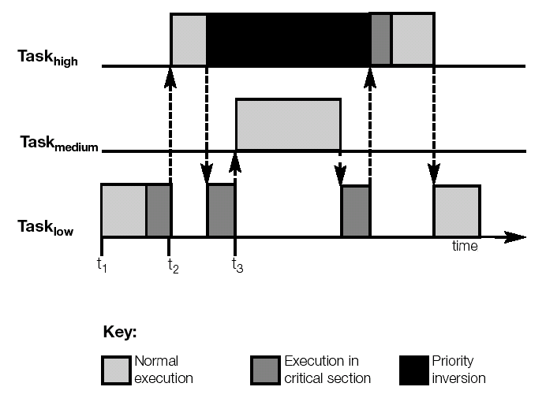
Priority Inversion

Slide 44
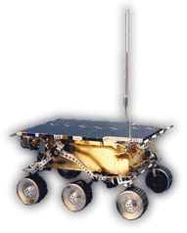
How Real is Priority Inversion?
Mars Pathfinder experienced total system resets
Operating system used: WindRiver’s VxWorks
Preemptive priority scheduling of threads
Pathfinder’s priority-based architecture
High-priority thread managed the information bus
Medium-priority thread ran a communications task
Low-priority data-gathering thread used bus to publish data
Bus access governed by mutex
What happened?
High-pri task blocked, waiting for low-pri task to release mutex
Interrupt would occur, causing med-pri task to be scheduled
Watchdog timer would notice that high-pri task did not run for a while, and cause a total system restart
Notes:
Vxworks had PCP disabled by default!

Slide 45
Why Are Deadlines Missed?
For a given task, consider
Preemption: time waiting for higher priority tasks
Execution: time to do its own work
Blocking: time delayed by lower priority tasks
The task is schedulable if the sum of its preemption, execution, and blocking is less than its deadline.
Focus: identify the biggest hits among the three and reduce, as needed, for schedulability
Notes:
9
Note:
For a task to meet its deadline, it must accommodate
Preemption from higher-priority tasks,
Its own execution time, and
Delays caused by lower-priority tasks (known as priority inversion or blocking).
Remember that higher-priority tasks, from a rate monotonic perspective, are those with higher rates (or shorter periods). These can occur more than once in a task’s period. A task’s execution occurs once during its period. And blocking can occur at most once during the task’s period; blocking comes from lower-priority tasks, those that have slower rates (or longer periods).
Preemption and execution are unavoidable. If these exceed capacity, one is faced with a classical throughput problem and the only remedy is to reduce the workload (which means changing the system requirements) or to increase the capacity by using a faster computer. Experience has shown that priority inversion (blocking), delay from lower-priority tasks, is a major source of missed deadlines. So we focus on identifying sources of priority inversion and try to reduce their blocking effects to enhance schedulability.

Slide 46
Metrics in Real-Time Systems – I
End-to-end latency:
E.g. worst-case, average-case, variance, distribution
Can involve multiple hops (across nodes, links, switches and routers)
Behavior in the presence or absence of failures
Jitter
Variability in metrics (e.g., variability in throughput)
Throughput
How many requests can be processed in unit time?
How many messages can be transmitted in unit time?
Robustness
How many faults can be tolerated before system failures?
What functionality gets compromised?

Slide 47
Metrics in Real-Time Systems – II
Safety & Certification
Is the system “safe”?
Can the system get into an ‘unsafe’ state? Has it been ‘certified’?
Modes and reconfiguration
What happens when the system mission changes?
What happens under mode changes?
What are examples of mode changes?
What happens when individual elements fail?
Can the system reconfigure itself dynamically?
How does the system behave after re-configuration?
Security
Can the system’s integrity be compromised?
Can violations be detected?
Renewed interest in this area with appliances being connected to the Internet

Slide 48
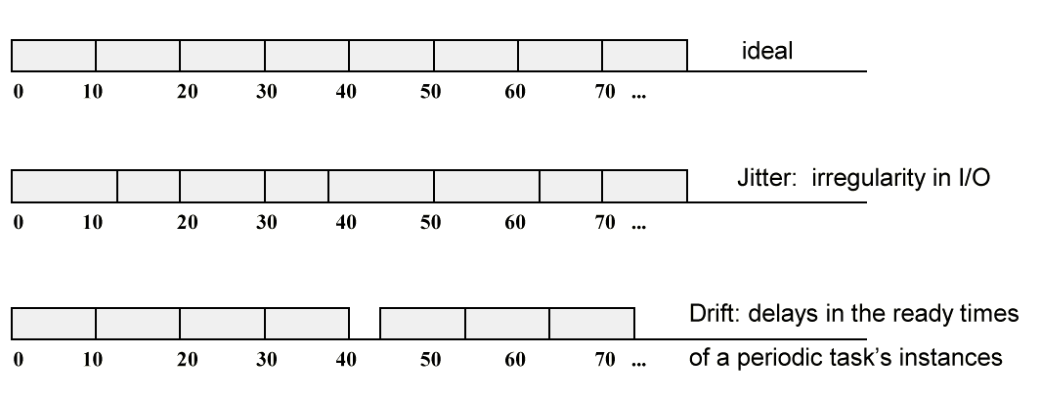
Drift and Jitter
Drift can be eliminated completely but one can only
hope to minimize jitter in general

Slide 49
Sources of Drift and Jitter
What can cause drift?
What can cause jitter?
How would you prevent drift?
How would you prevent jitter?
If I gave you a piece of code and asked you to spot all of the places where jitter and drift could occur, how you would go about it?
Notes:
think of paging, multi-tasking and preemption

Slide 50
Scheduling
Scheduler = resource allocator that affects the timing of real-time services
Offline scheduler = does allocation at design time
Online scheduler = does allocation at run-time
Schedulers need to know dependencies and worst-case behavior
Worst-case execution time (WCET) is often required to be known in real-time systems
How do you determine worst-case behavior?

Slide 51
Classification of Scheduling Algorithms
All scheduling algorithms
static scheduling
(or offline, or clock driven)
dynamic scheduling
(or online, or priority driven)
static-priority
scheduling
dynamic-priority
scheduling

Slide 52
Scheduling Algorithms (No Priority)
Non-priority-based
All tasks are created equal
There is no way to indicate which tasks are more “important” (more critical) than others
First-In-First-Out (FIFO) or First-Come-First-Served (FCFS)
Ready tasks are inserted into a list
Tasks are dispatched from the list in their order of entry in the list
No preemption, i.e., a task runs to completion before the next task runs
No consideration of task priorities
Round-Robin Preemptive
Ready tasks are dispatched in turn
Each task given its fair share of fixed execution time
Preemption of running task at the end of the fixed interval
No consideration of task priorities

Slide 53
Scheduling Algorithms (Fixed-Priority)
Fixed-priority based
All tasks are not created equal
Some tasks have more importance (higher priority) than others
Once a task’s priority is assigned, it cannot change during run-time
Rate Monotonic Analysis (RMA)
Shorter the period, the higher the priority of the task
Assigns fixed priorities in reverse order of period length
Tasks requiring frequent attention have higher priority and get scheduled earlier
Least Compute Time (LCT)
Shorter the computation time, the higher the priority of the task
Assigns fixed priorities in reverse order of computation length
Tasks finishing quickly have higher priority and get scheduled earlier

Slide 54
Scheduling Algorithms (Dynamic-Priority)
Dynamic-priority based
All tasks are not created equal
Some tasks have more importance (higher priority) than others
Task’s priority (and thus, the schedule) may change during execution
Shortest Completion Time (SCT)
Ready task with the smallest remaining compute time gets scheduled first
Earliest Deadline First (EDF)
Ready task with the earliest future deadline gets scheduled first
Least Slack Time (LST)
Ready task with the smallest amount of free/slack time within the cycle gets scheduled first

Slide 55
Real-Time Standards
Real-Time Operating System standards
IEEE 1003.1b POSIX Real-Time Extensions
OSEK (automotive real-time OS standard)
Real-Time (and Concurrent) Programming Languages
Real-Time Specification for Java
Ada 83 and Ada 95
Real-Time Middleware
Real-Time CORBA
Networks/buses
CANbus (Controller Area Network bus)
TTA: Time-Triggered Architecture (www.tttech.com)
FlexRay (www.flexray.org)

Slide 56
Rate Monotonic Scheduling
A task with a shorter period has a higher deadline
Shorter Period -> Higher priority
0
1
2
3
4
5
6
7
8
9
10
11
12
13
14
15
16
17
18
19
20
21
22
{ C,T }
τ₁
{1,4}

Slide 57
Rate Monotonic Scheduling
A task with a shorter period has a higher deadline
Shorter Period -> Higher priority
0
1
2
3
4
5
6
7
8
9
10
11
12
13
14
15
16
17
18
19
20
21
22
{ C,T }
τ₁
{1,4}
τ₂
{2,5}
τ₃
{2,10}

Slide 58
Rate Monotonic Scheduling
Optimal Static Priority Scheduling
A task with a shorter period has a higher deadline
Shorter Period -> Higher priority
0
1
2
3
4
5
6
7
8
9
10
11
12
13
14
15
16
17
18
19
20
21
22
{ C,T }
τ₁
{1,4}
τ₂
{2,5}
τ₃
{2,10}

Slide 59
Rate Monotonic Scheduling
Optimal Static Priority Scheduling
A task with a shorter period has a higher deadline
Shorter Period -> Higher priority
0
1
2
3
4
5
6
7
8
9
10
11
12
13
14
15
16
17
18
19
20
21
22
{ C,T }
τ₁
{1,4}
τ₂
{2,5}
τ₃
{2,10}

Slide 60
Rate Monotonic Scheduling
Optimal Static Priority Scheduling
A task with a shorter period has a higher deadline
Shorter Period -> Higher priority
0
1
2
3
4
5
6
7
8
9
10
11
12
13
14
15
16
17
18
19
20
21
22
{ C,T }
τ₁
{1,4}
τ₂
{2,5}
τ₃
{2,10}

Slide 61
Summary
Example real-time systems
Simple control systems, multi-rate control systems, hierarchical control systems, signal processing systems
Terminology
Priority inversion
Scheduling algorithms (Overview)
Next Up: Rate Monotonic Scheduling and Analysis
Notes:
24
Use of rate monotonic theory provides the ability to predict timeliness and guarantee that deadlines will always be met. But more importantly, it provides insight into the hardware and software design that affect system timing performance and helps to identify possible bottlenecks and errors that degrade schedulability, i.e. the ability to meet deadlines.
Performing the analysis provides predictability of system performance during system design and allows the separation of timing and functional concerns. In essence, RMA provides an engineering approach to designing real-time systems, in the way that physics provides predictability in building bridges.

